Slide 1
The Battle of Neighborhoods
by Roger Burek-Bors - November 23, 2020 - Warsaw, Poland
https://github.com/rodbergerrone/Coursera_Capstone

Slide 2
Agenda
Introduction
Data
Methodology
Results
Discussion
Conclusion

Slide 3
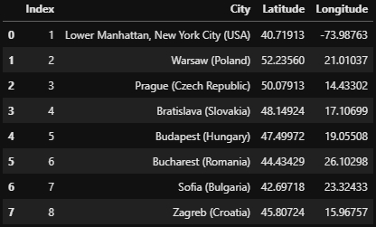
Introduction
"ABC123 is a leading American consulting company based in New York City, Manhattan. ABC123 employs English-speaking personnel, specialized in law, finance, audits, etc.
ABC123 wants to explore business opportunities in the Central and Eastern Europe (CEE). ABC123 would like to establish a common office for entire CEE region and move some of current American personnel to the new location. It is expected that the new office will be in the capitol of the European Union member that joined after 2000. The new location must be comparable to Manhattan when it comes to social life (e.g. restaurants and entertainment). Second factor to compare is flight network, especially frequency of direct flights between New York City and particular location, and between analyzed locations themselves, that would lead to selection of an optimal place to run business. Last factor to compare would be: cost of life and presence of English-spoken schools since the US-personnel will be relocated with families."

Slide 4
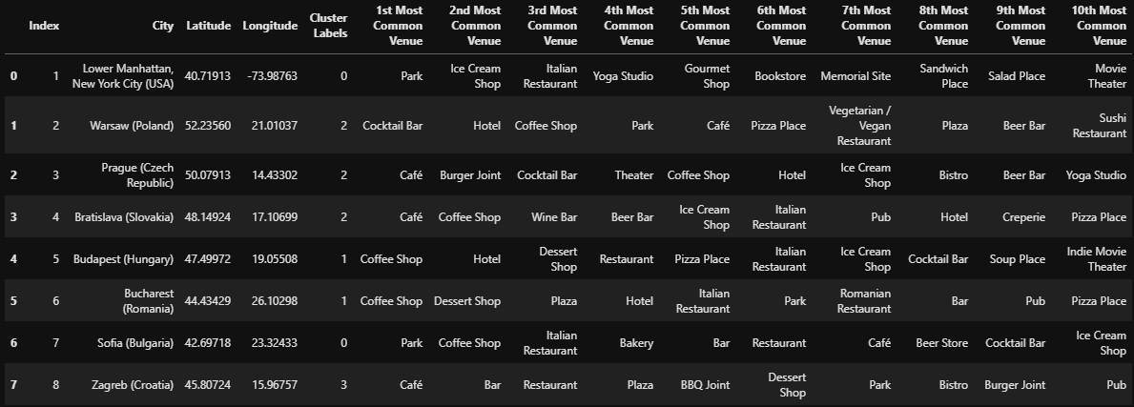
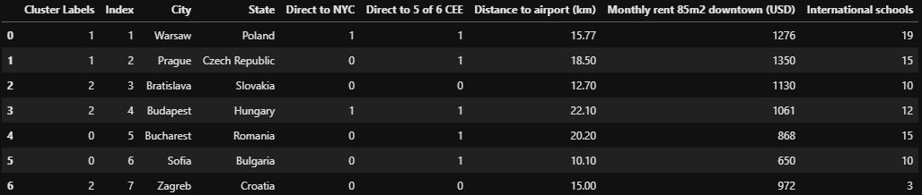
Data
Collected from Foursquare API:
Manually compiled from popular websites:

Slide 5
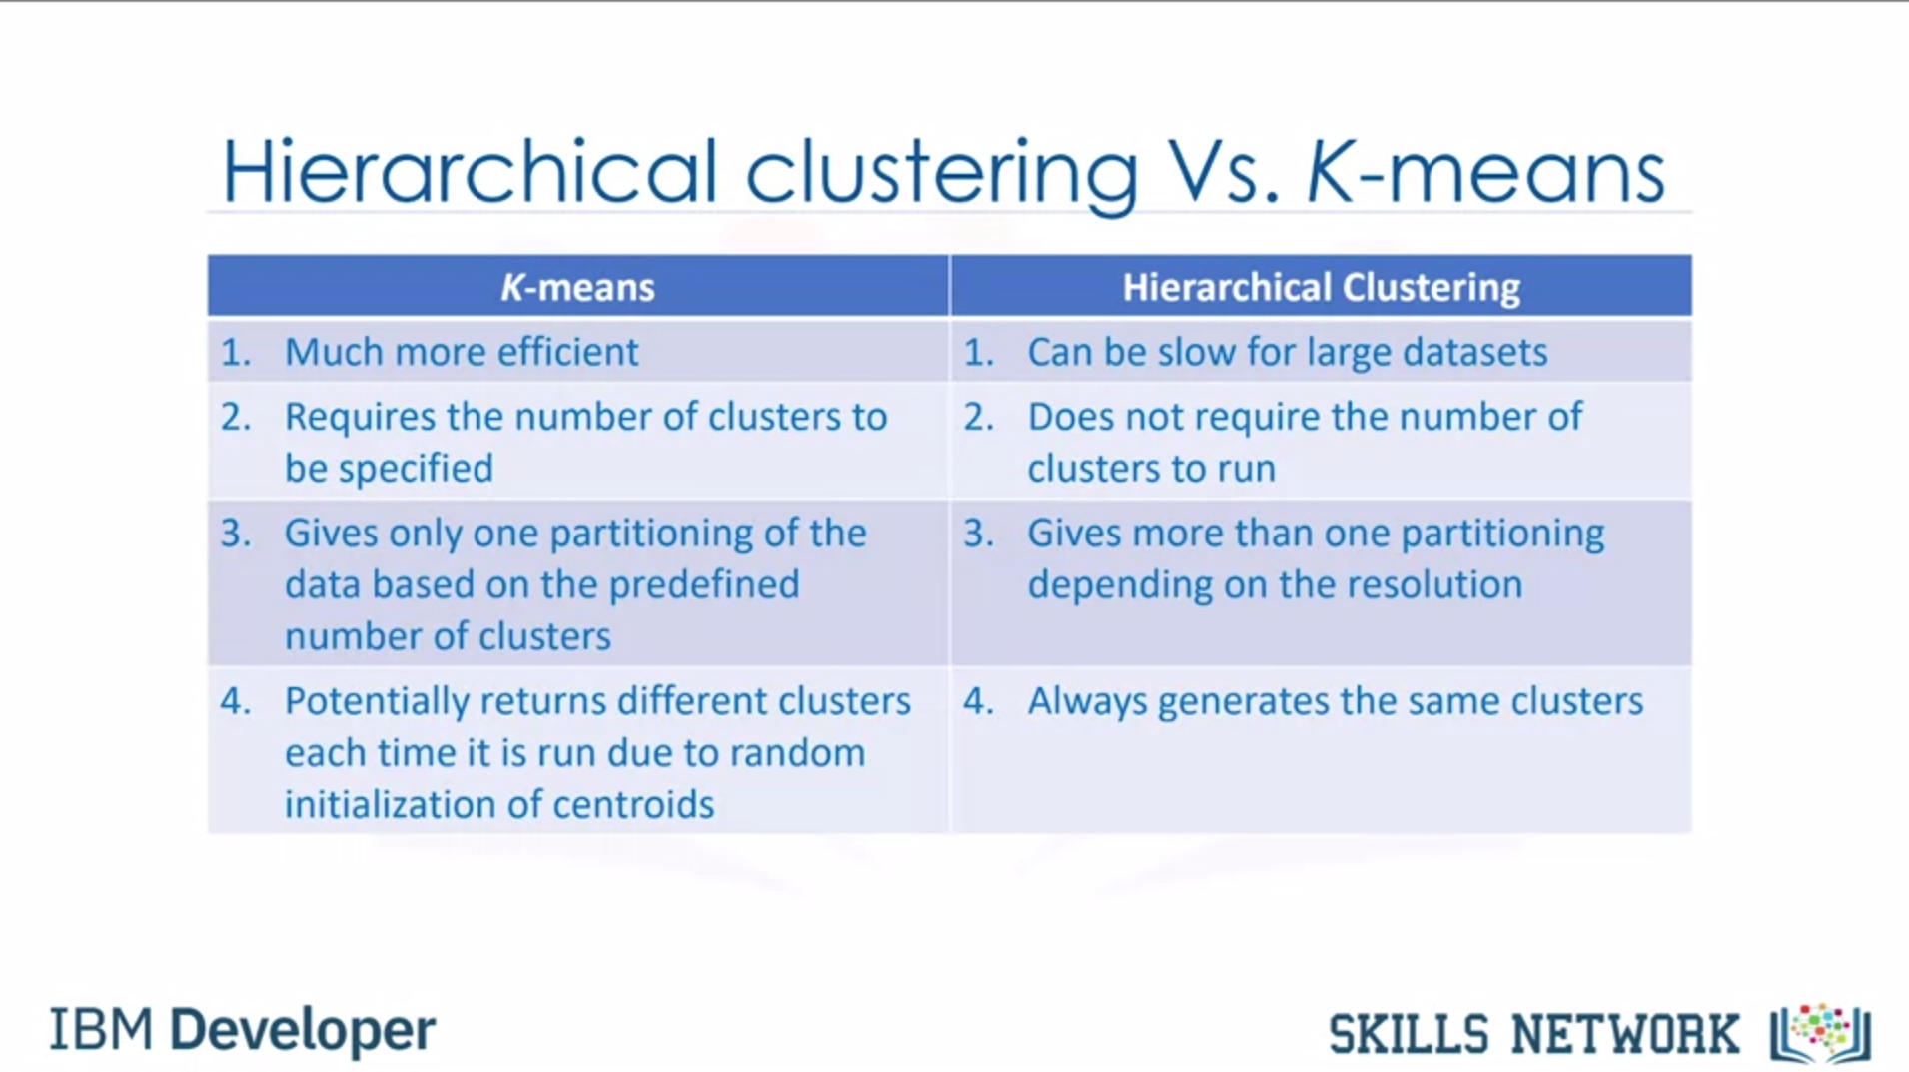
Methodology

Slide 6
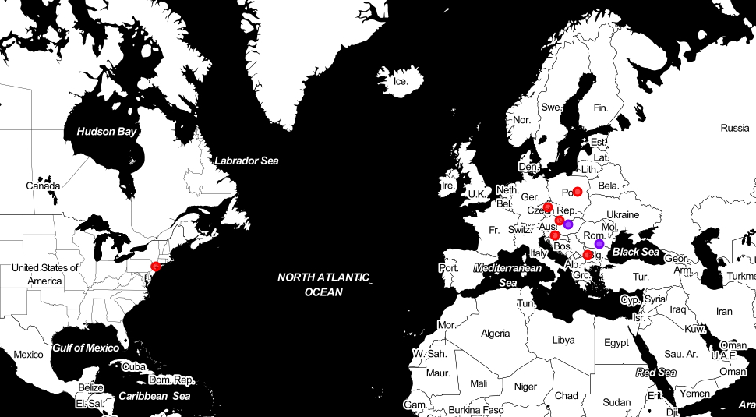
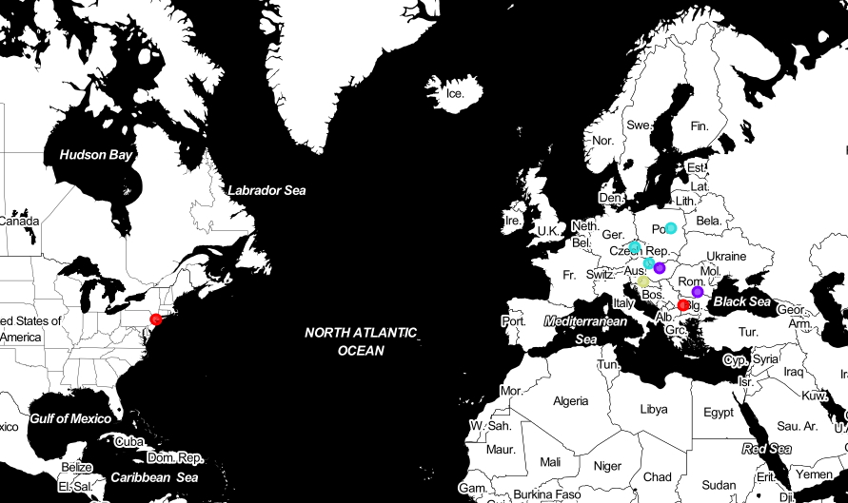
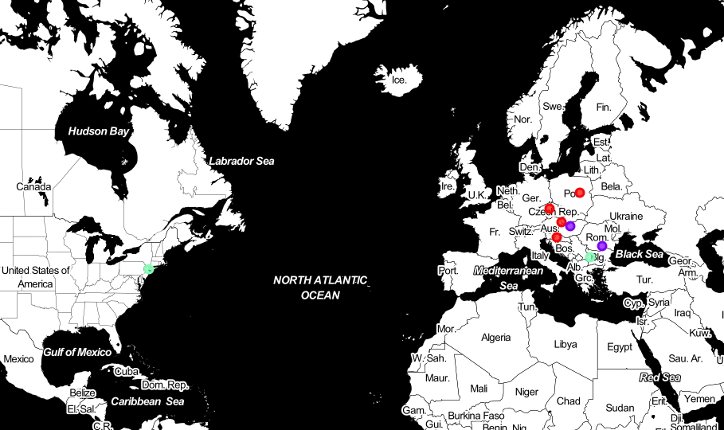
Results (1)
3 iterations and limiting number of clusters helped to decide which cities are the most similar to Lower Manhattan when it comes to social life.

Slide 7
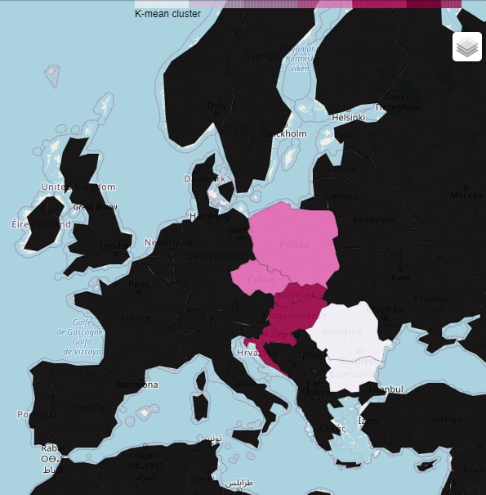
Results (2)
Warsaw or Prague – well connected in the region and NYC with good international education system, however renting 85m2 flat is the most expensive
Sofia or Bucharest – well connected in the region, also with decent international schools, the cheapest when it comes to renting 85m2 flat
Budapest or Bratislava or Zagreb – do not provides flight connection to all CEE capitols, less international schools but decent prices for renting 85m2 flat

Slide 8
Discussion
Successfully explored venues in 8 cities via Foursquare API then applied k-mean clustering
Successfully compiled additional dataframe with information about flights, cost of living and international schools with English language as leading, then also applied k-meam clustering

Slide 9

Conclusion
Under real circumstances I would advise ABC123 to open common office for CEE region either in Warsaw (Poland) or Prague (Czech Republic) as these cities provides similar social life, are well connected with all analyzed CEE capitals and provide access to the biggest number of international schools. American expats should enjoy working and living there, as well as their spouses and children.

Slide 10
Thank you for attention
https://www.linkedin.com/in/roger-burek-bors-422398175/

